Slide 1


Python Fundamentals
Innovation Masters
Day 16

Slide 2

Today’s Agenda
Learning about file read/write
Using it to save information from programs
Finalize our CIA profile maker with files
Make a program on your own for a real estate agency

Slide 3
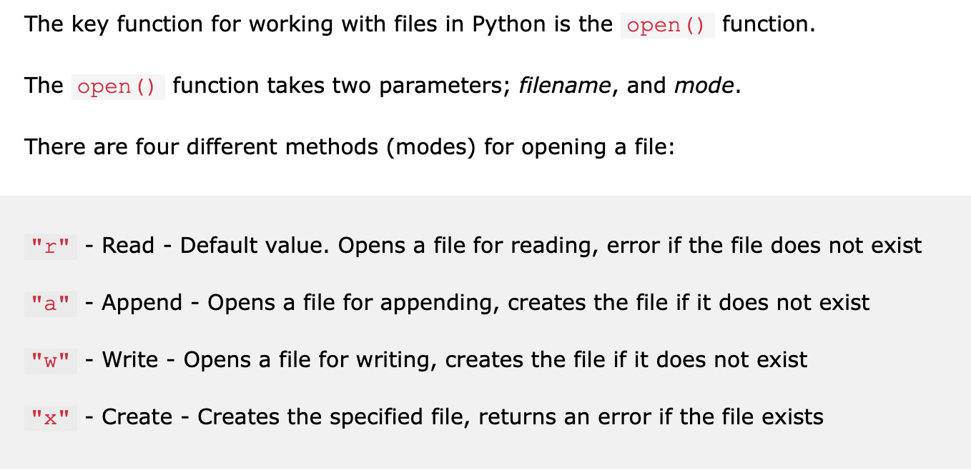
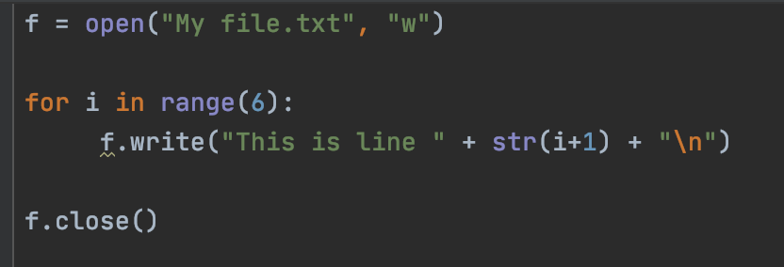
Write to a file

Slide 4
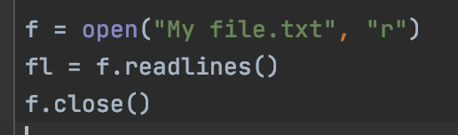
Read from a file

Slide 5
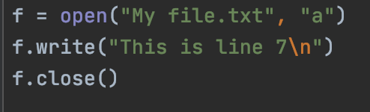
Append to a file

Slide 6
CIA Profiles
Let’s incorporate file read and write
We will use files to save profiles for later use
We will read from files to retrieve profiles
Learn how to separate information from lines in files

Slide 7

Real Estate Agency
Make a class (blueprint) for a house
Area
Bedrooms
Bathrooms
Price
Take user input to make house objects
Save houses in a file so that you can read later

Slide 8
Tech Talk
https://www.youtube.com/watch?v=XZ4hZx6K85Y
Start from 3 minutes
https://www.youtube.com/watch?v=_BvB0182xag

